Slide 1

FALL 2023
MIS 381N
Information management
Lecture 18
Oct 23rd 2023
Prashant D. Joshi
UT McCombs School of Business (MSBA), The University of Texas at Austin

Slide 2

Objectives
MapReduce and Graph Databases
Recap MapReduce, intro to Hadoop
Class Discussion
Questions and discussion

Slide 3
What questions may I answer before we begin …
All questions are good questions

Slide 4
Housekeeping
Project progress?
Project reps: Can you give your team’s progress so far?
Midterm exam results not yet there… Sorry! Will have the TAs grade the SQL part soon and have your results this weekend
Assignment 3…. ☹
New Assignment on Canvas (dealing with Hadoop and MapReduce)
Interest in Kubernetes? We can have one homework on that if there is interest in the class

Slide 5
MapReduce Recap

Slide 6
The MapReduce software stack includes …
Partitioning the input data
Scheduling the program’s execution across a set of machines
Performing the group by key step
Handling machine failures
Managing required inter-machine communication

Slide 7
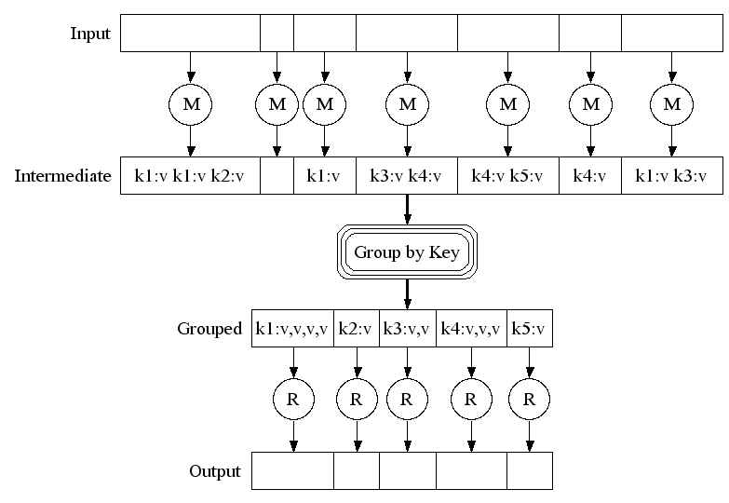
MapReduce Summary
Big document
MAP:
Read input and produce a set of key-value pairs
Group by key:
Collect all pairs with same key
(Hash merge, Shuffle, Sort, Partition)
Reduce:
Collect all values belonging to the key and output

Slide 8
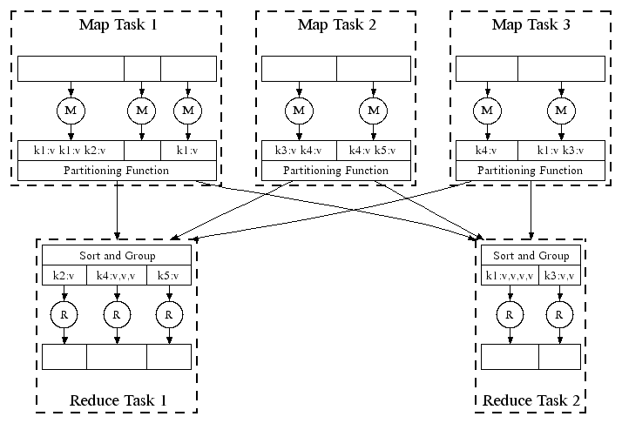
Parallelism in MapReduce
All phases are distributed with many tasks doing the work

Slide 9
MapReduce workflow
Programmer specifies
Map function, Reduce function, and input files
Workflow
Read inputs as a set of key-value-pairs
Map transforms input kv-pairs into a new set of k'v'-pairs
Sorts & Shuffles the k'v'-pairs to output nodes
All k’v’-pairs with a given k’ are sent to the same reduce
Reduce processes all k'v'-pairs grouped by key into new k''v''-pairs
Write the resulting pairs to files
All phases are distributed with many tasks doing the work
Input 0
Input 1
Input 2
Map 0
Map 1
Map 2
Shuffle
Reduce 0
Reduce 1
Out 0
Out 1

Slide 10
Data Flow
Input and final output are stored on a distributed file system
Scheduler tries to schedule map tasks “close” to physical storage location of input data
Intermediate results are stored on local file systems of Map and Reduce servers
Output is often input to another MapReduce task

Slide 11
Task Coordination
Master node takes care of coordination
Task status: (idle, in-progress, completed)
Idle tasks get scheduled as workers become available
When a map task completes, it sends the master the location and sizes of its R intermediate files, one for each reducer
Master pushes this info to reducers
Master pings workers periodically to detect failures

Slide 12
Dealing with failure
Map worker failure
Map tasks completed or in-progress at worker are reset to idle
Reduce workers are notified when task is rescheduled on another worker
Reduce worker failure
Only in-progress tasks are reset to idle
Reduce task is restarted
Master failure
MapReduce task is aborted, and client is notified

Slide 13
How many Map and Reduce jobs?
M map tasks, R reduce tasks
Rule of a thumb:
Make M larger than the number of nodes in the cluster
Improves dynamic load balancing and speeds up recovery from worker failures
Usually, R is smaller than M
Because output is spread across R files
Why? Can the options be quantized?

Slide 14
Refinement: Combiners
Often a Map task will produce many pairs of the form (k,v1), (k,v2), … for the same key k
E.g., popular words in the word count example
Can save network time by pre-aggregating values in the mapper:
combine(k, list(v1)) → v2
Combiner is usually same as the reduce function
Works only if reduce function is commutative and associative
Why? (*)
*: If order matters then there are other issues

Slide 15
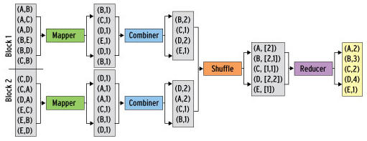
Refinement: Combiners (Word counting)
Combiner combines the values of all keys of a single mapper (single machine)
Much less data needs to be copied and shuffled

Slide 16
Hadoop and MapReduce

Slide 17
Hadoop
Hadoop is a framework designed for storage and processing of large volumes of data
Primary components
Hadoop Distributed File System (HDFS) for storage
Hadoop MapReduce processing engine
YARN (Yet Another Resource Negotiator)

Slide 18
HDFS
Storage
Distributed file system to store vast amounts of data across a cluster of commodity hardware
Divides data into smaller blocks, replicated them across multiple nodes (why?)
Scalability
Highly scalable (horizontally)
Accommodates structured and unstructured data
Data Resilience
Replication ensure availability. (recall RAS)

Slide 19
Hadoop MapReduce
Processing
This is a programming model and processing engine for distributed parallel data processing
Map Phase
A Map function is applied to the data to process and filter data giving intermediate key-value pairs
Shuffle and Sort
This intermediate data is shuffled and sorted based on keys to group them
Reduce
The sorted/grouped data is applied the Reduce function to get aggregated results

Slide 20
YARN
Central component of the Hadoop system
Serves as the cluster resource management and job scheduling system
ResourceManager: Managing cluster resources, scheduling
NodeManager: Runs and monitors worker nodes, resources, and reports to the ResouceManager. Also launch and monitor containers.
ApplicationMaster: Each application has this, and negotiates resources from the RM, tracks progress of application
Container: Isolated execution environments, encapsulated with resources, CPU, memory etc
Resource Scheduling: Scheduling policies for resource sharing
Compatible with different processing engines: Such as Apache Spark and others

Slide 21
Hadoop Ecosystem
HDFS: storage system
Hive: Data warehousing and SQL-like language for Hadoop
Pig: platform for processing ETL processes
Spark: Not original part of Hadoop, but often integrated into Hadoop clusters for in-memory work
Kafka: Not original part of Hadoop, but often used for real-time data streaming and messaging (high throughput, fault tolerance, scalable)
From above examples, it is a versatile and flexible framework, and continues to evolve as a collection of open-source projects

Slide 22
10 minutes break….In Class Discussion
In Canvas → Files → Readings → ‘How to build a data architecture….’
Break up into SIX teams
Each team reads the full paper, but takes on one question to answer after reading it
Do not restrict yourself to the paper only!!!!
Do talk about your own experience, prior knowledge, or from other sources about your question

Slide 23
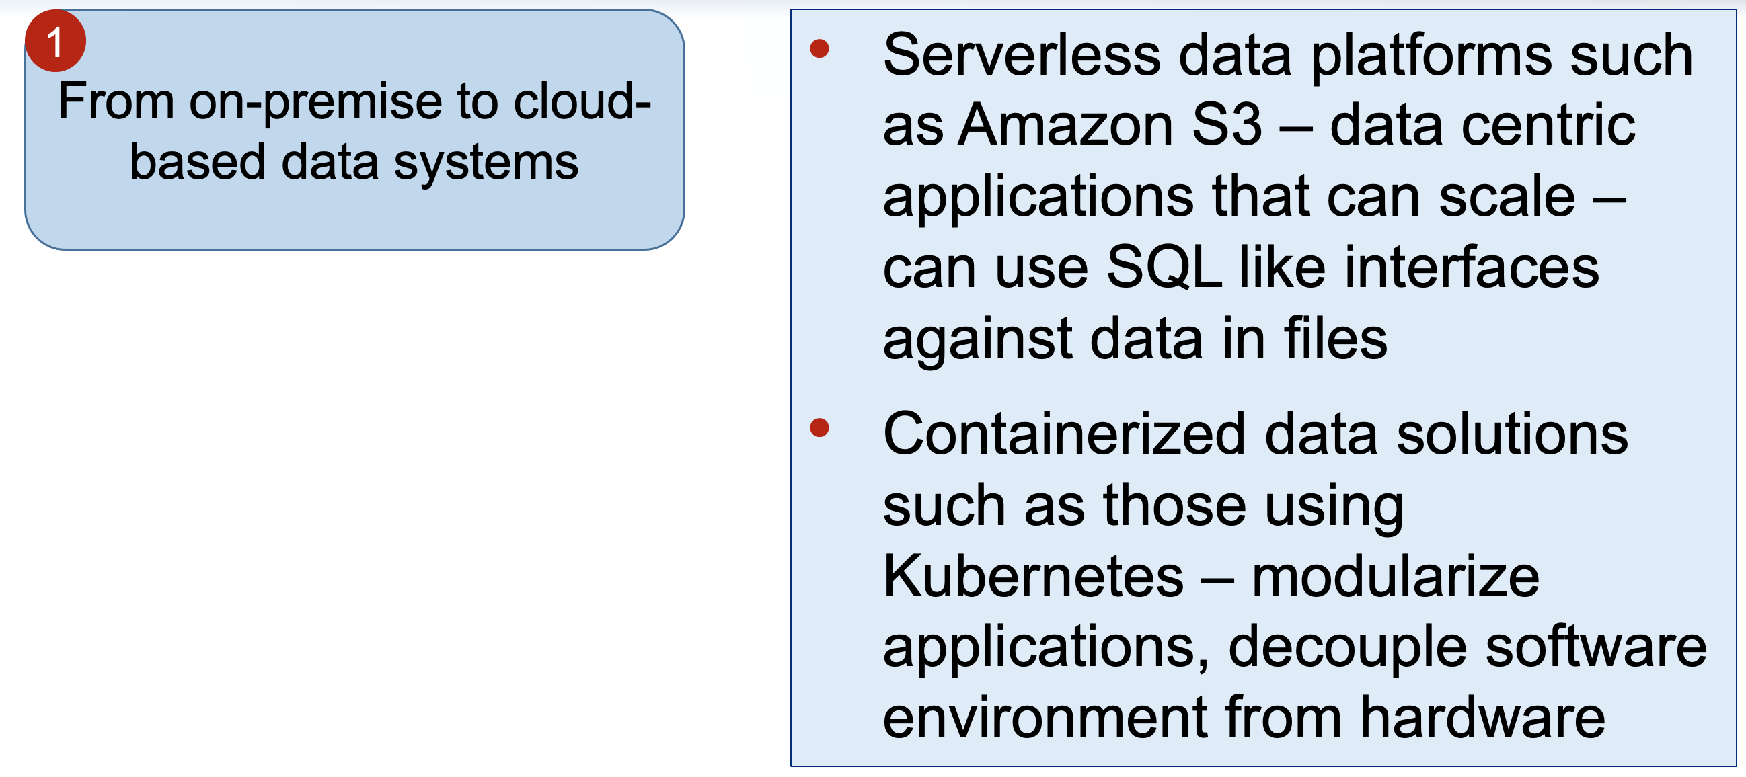
Six Shifts
What is Kubernetes? | IBM
https://www.ibm.com/cloud/kubernetes-service/kubernetes-tutorials

Slide 24
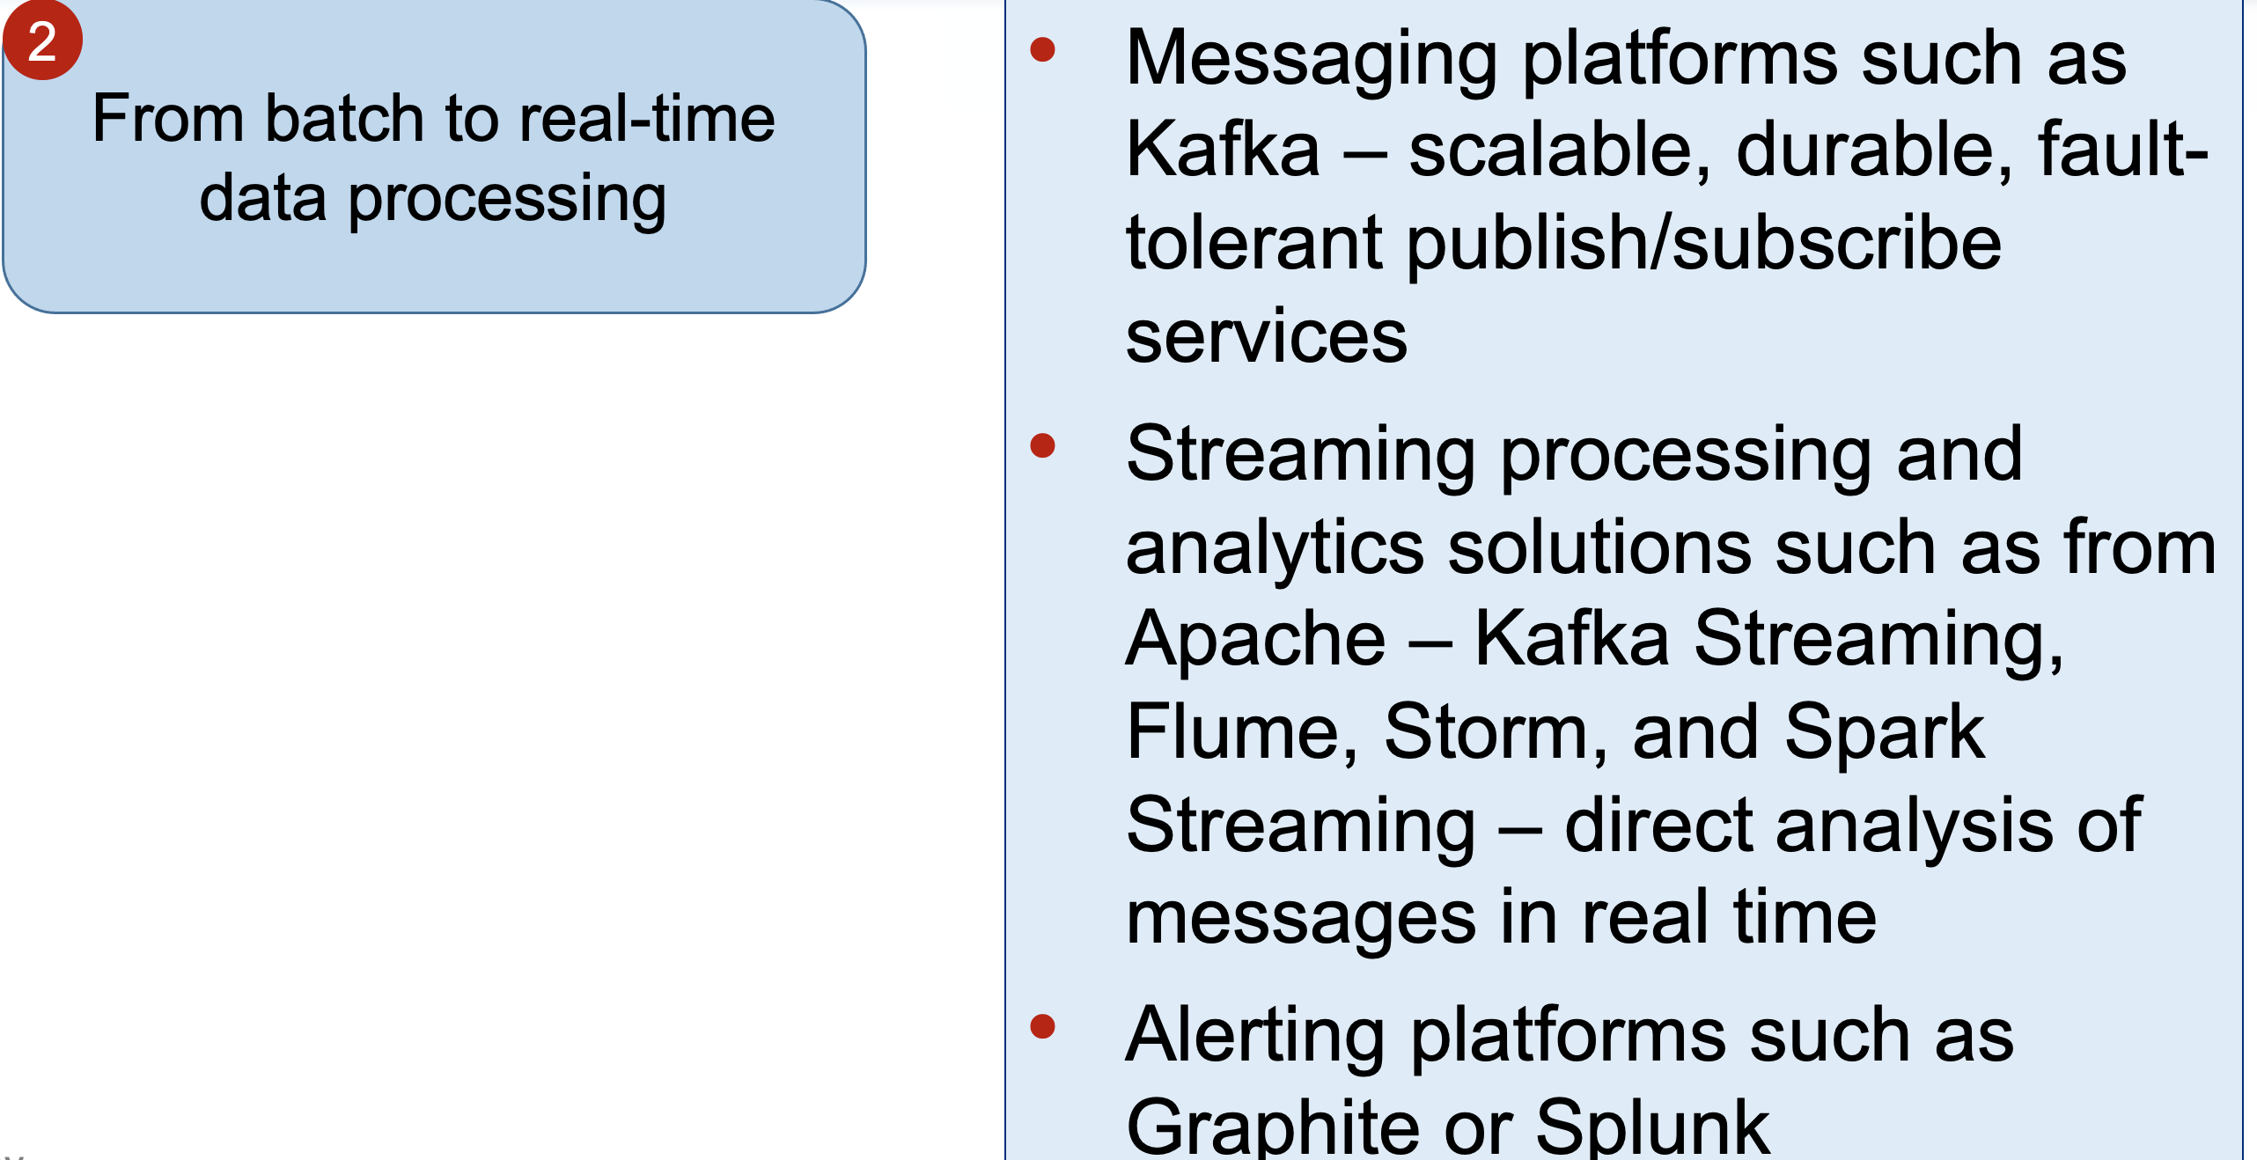
Six Shifts
Why has this become possible?
IOT? ML? Networks?

Slide 25
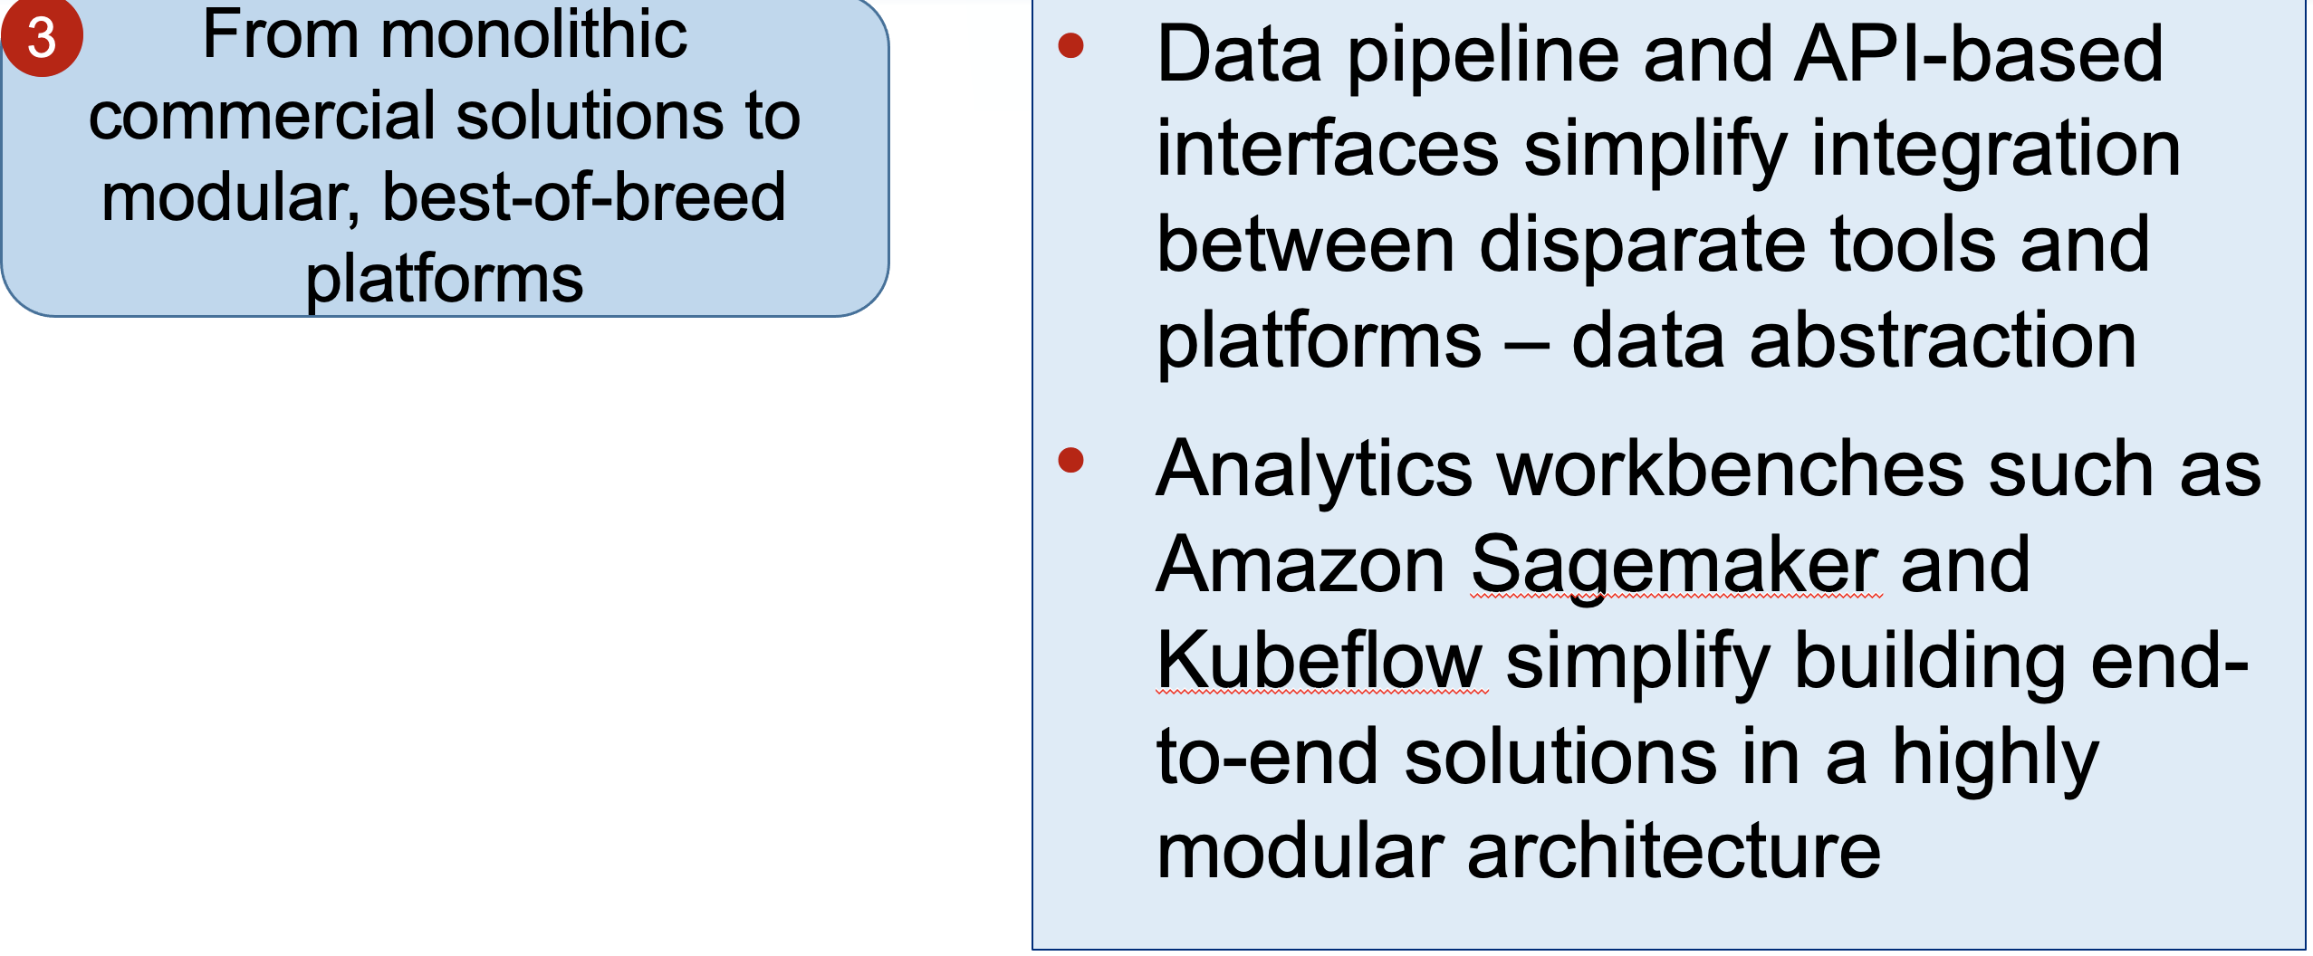
Six Shifts
Open source, modularized replacements make such shifts easy?

Slide 26
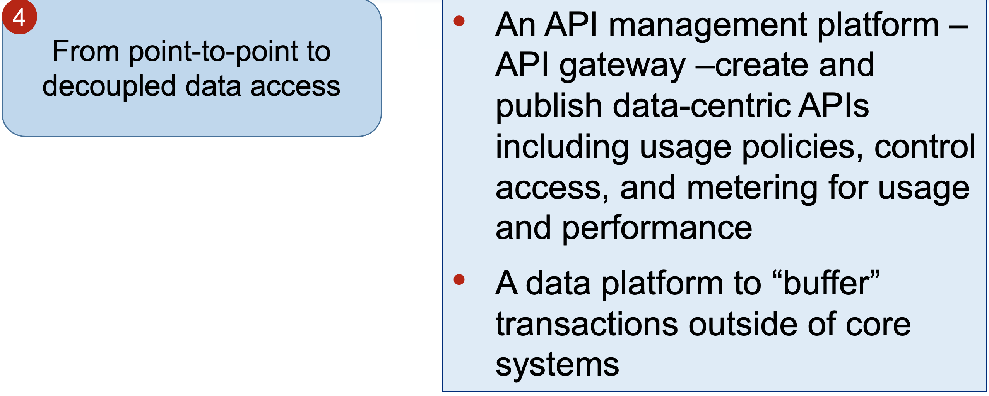
Six Shifts
What are the issues of p2p connections?
How does decoupled access solve this?

Slide 27
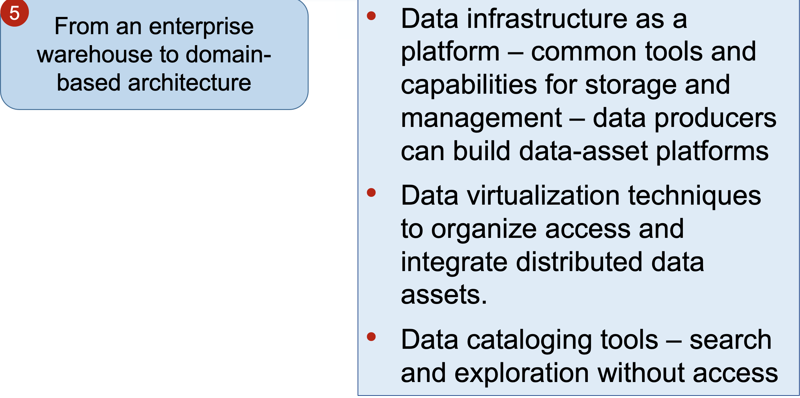
Six Shifts
What issues need to be resolved to enable this? Flexibility? Scalability? How about redundancy or integration complexity?

Slide 28
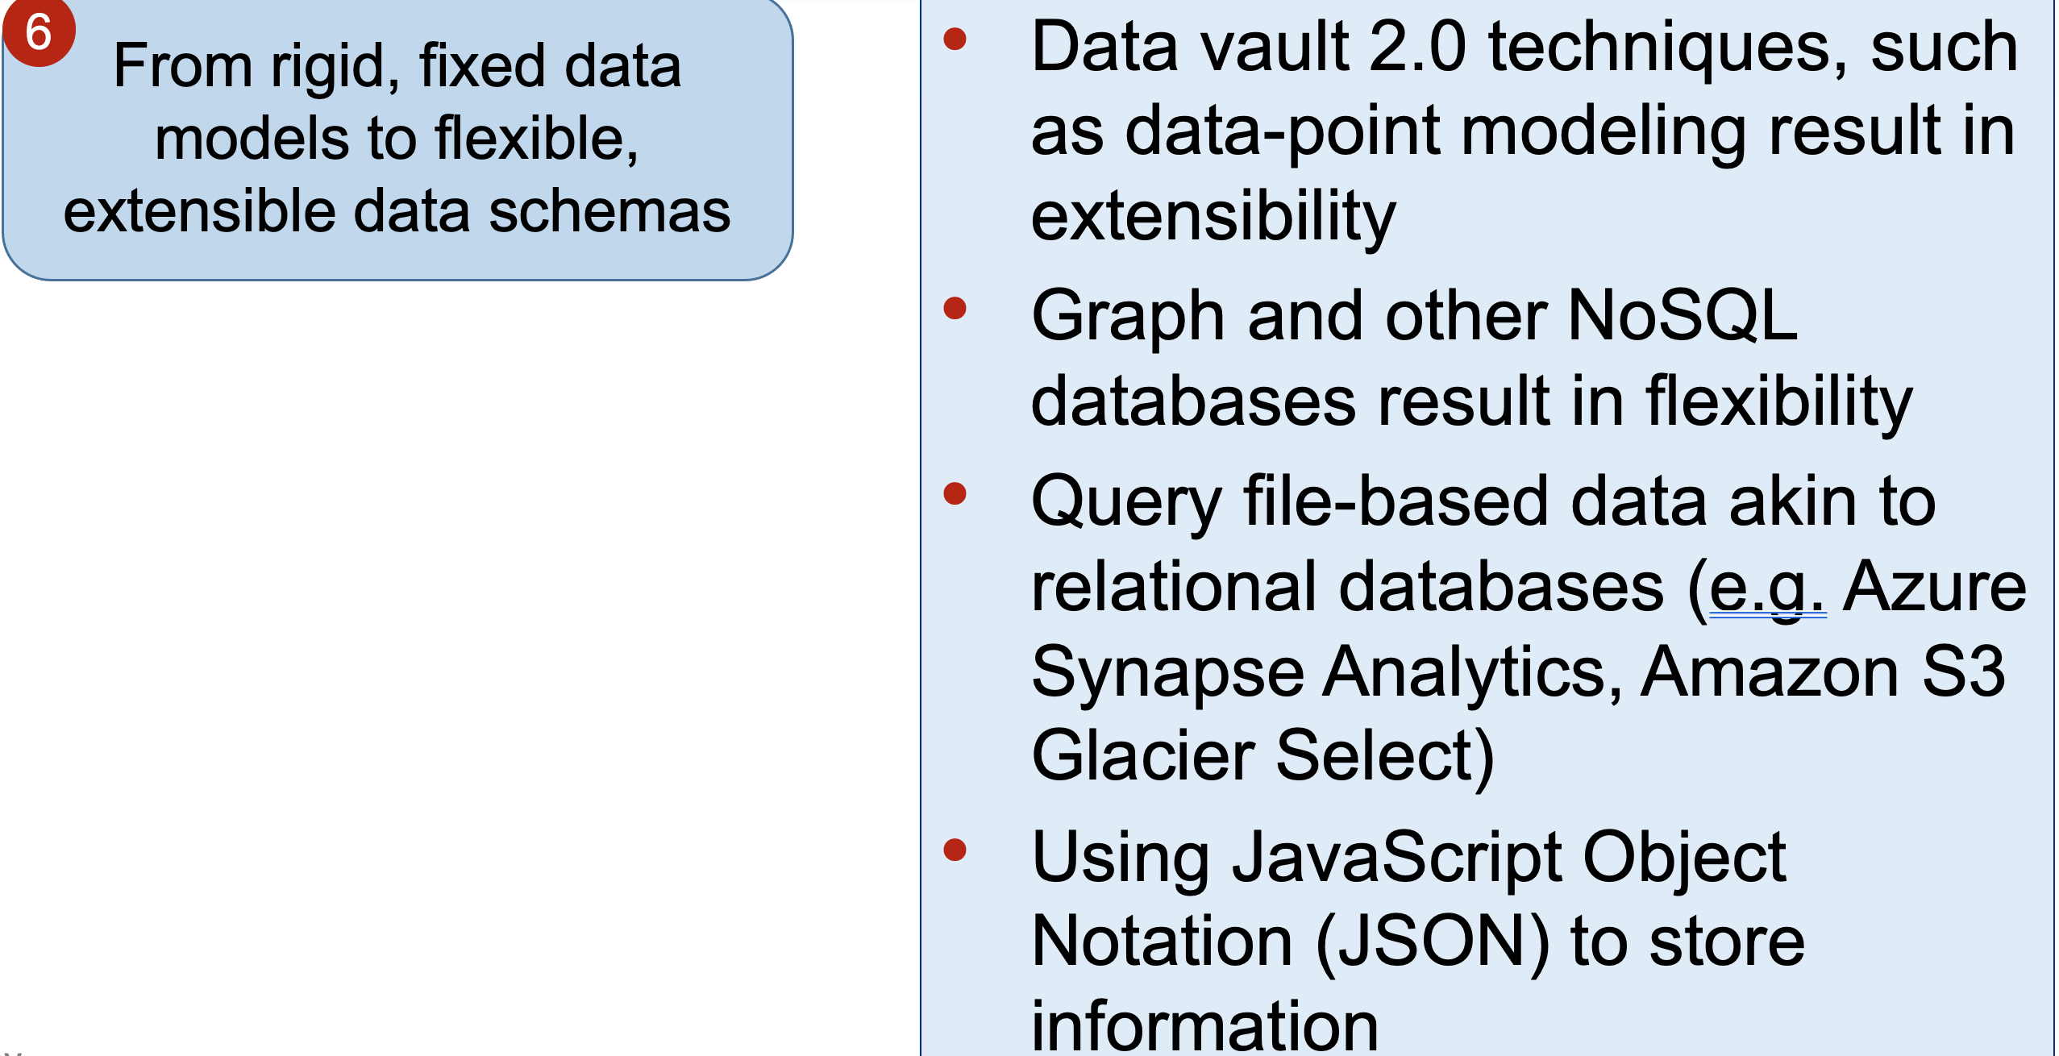
Six Shifts
Enhanced data quality? Adaptability? Agility?

Slide 29

Next class
More NoSQL tools and frameworks!
Final Project progress
Read articles and review videos (if any) posted on Canvas
Come prepared to discuss and work in teams

Slide 30
What questions may I answer before we conclude …
All questions are good questions

